Slide 1

Sonic-Self: An Analysis of Music's Relationship with Student Wellbeing
Dr. Br. AMBEDKAR NATIONAL INSTITUTE
OF TECHNOLOGY
DMA Project Report
Submitted by:
Ritik Gupta - 23103122
Rishi Raj Anand - 23103121
Submitted to:
Dr. Jagdeep Kaur

Slide 2
INTRODUCTION
Study explores how music habits relate to overall life satisfaction in college students.
College life involves high academic pressure and social changes affecting wellbeing.
Research question:
👉 Is it what students listen to, or how they use music, that impacts life satisfaction?
Data collected across 4 key areas:
  Life Satisfaction – Self-rated score (1–10)
  Foundational Health – Sleep duration, social circle size
  Music Habits – Listening time, platforms, genres
  Emotional Function – Feelings experienced while listening
Key finding:
  Sleep and social connections are main wellbeing drivers.
  Music acts as an emotional regulator—how it’s used matters more than genre.
  Using music to calm, focus, or process emotions strongly correlates with higher life satisfaction.

Slide 3
METHODOLOGY
Dataset:
  Survey data from college students
  Target Variable: life_satisfaction (score 1–10)
  Goal: Identify key factors influencing life satisfaction
Predictor Variables:
  Life Factors: Sleep duration, Social circle size
  Music Habits: Listening hours/day, Platform (Spotify, YouTube, etc.), Genres, Feelings while listening
Analysis Stages:
  Univariate Analysis – Visualized individual factors (sleep, music use, satisfaction) to profile average students.
  Bivariate & Multivariate Analysis – Used violin plots, boxplots, heatmaps to study relationships between variables.
  Predictive Modeling – Applied Regression Tree (rpart) to rank factors affecting life satisfaction and derive “if–then” rules.

Slide 4
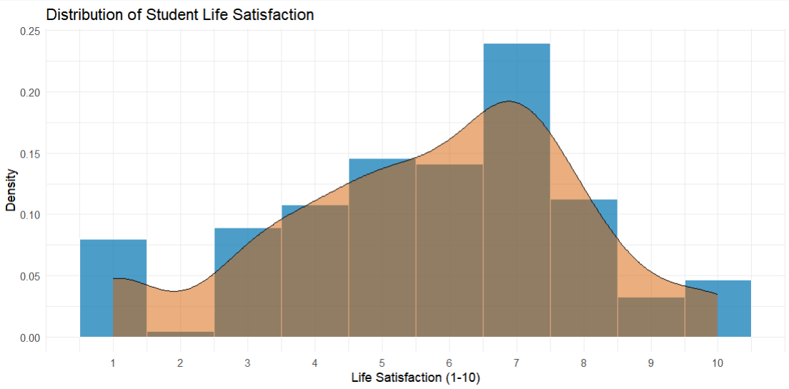
Results and Analysis
Profile of the Student Cohort:
Graph 1: Distribution of Student Life Satisfaction
Wellbeing scores are not normally distributed.
Most common life satisfaction score = 7.
A second cluster (3–5 range) indicates a “struggling” group.
Suggests two student segments: thriving vs. struggling — key factors analyzed to differentiate them.

Slide 5
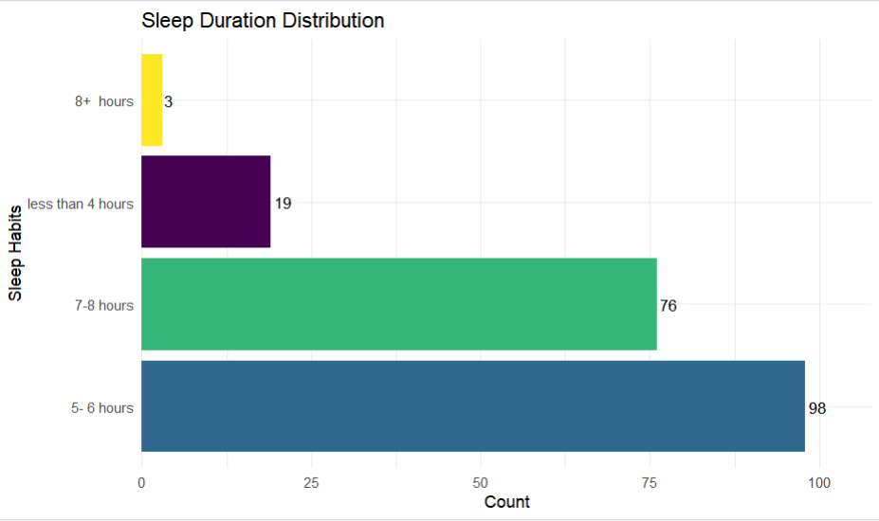
Results and Analysis
Profile of the Student Cohort:
Graph 2: Sleep Duration Distribution
Most common sleep duration: 5–6 hours (98 students).
Second most common: 7–8 hours (76 students).
Majority of students are clinically sleep-deprived.
Indicates sleep deficiency is a key factor affecting life satisfaction.

Slide 6
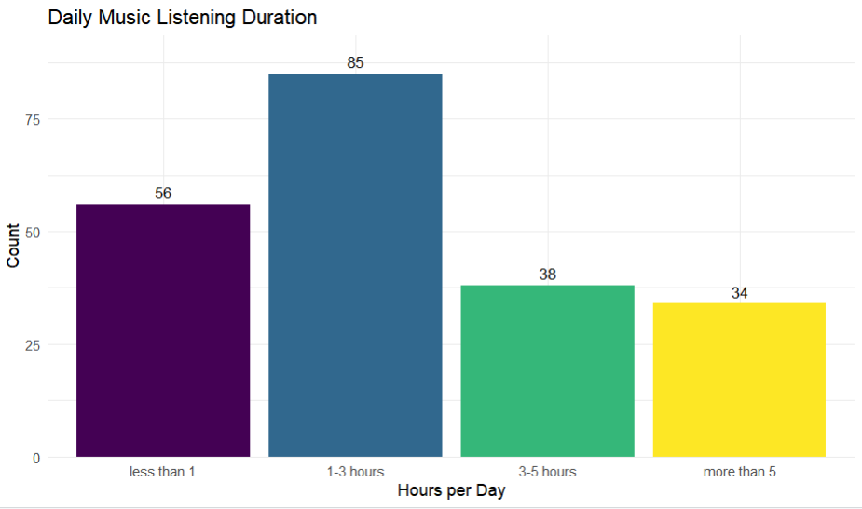
Results and Analysis
Profile of the Student Cohort:
Graph 3: Daily Music Listening Duration
Most common: 1–3 hours/day (85 students).
Next: Less than 1 hour/day (56 students).
Smaller group: More than 5 hours/day (34 students).
Shows that moderate listening is the norm, with a few heavy listeners.

Slide 7
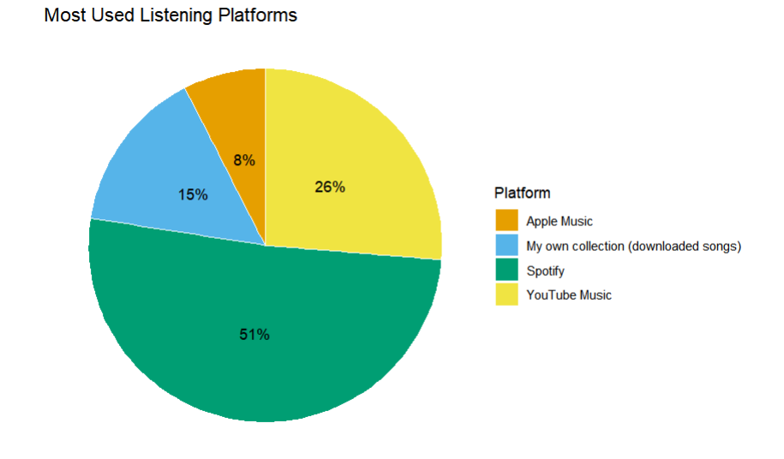
Results and Analysis
Profile of the Student Cohort:
Graph 4: Most Used Listening Platforms
Market Domination: Spotify leads with 51% of listeners.
Clear Second: YouTube Music holds 26% of the market.
Listener Behavior: This suggests algorithmic, playlist-driven listening is the norm.

Slide 8
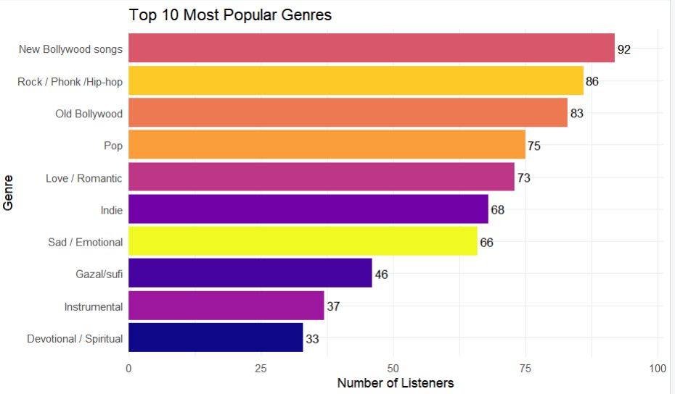
Results and Analysis
Profile of the Student Cohort:
Graph 5: Top 10 Most Popular Genres
Top genres: New Bollywood (92) and Rock /Phonk /Hip-hop (86).
Notable trend: “Sad/Emotional” music (66) ranks high.
Shows students often choose music for emotional connection, not just style.
Indicates music’s emotional role in coping and self-expression.

Slide 9
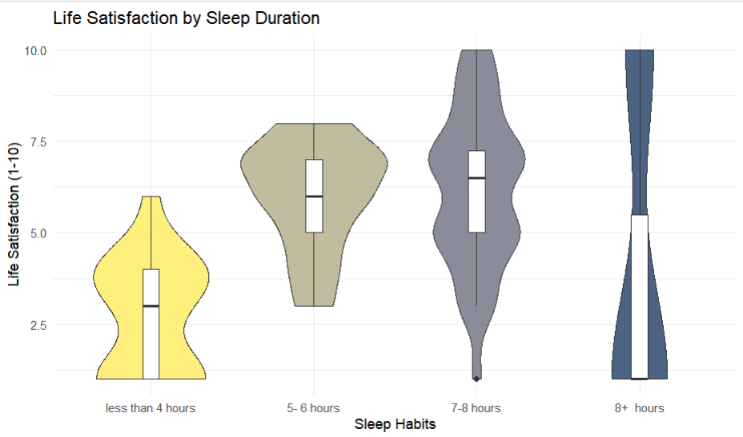
Results and Analysis
Profile of the Student Cohort:
Graph 6: Life Satisfaction by Sleep Duration
Clear positive relationship between sleep and life satisfaction.
Longer sleep → higher median satisfaction scores.
Students sleeping <4 hours report the lowest wellbeing.
Confirms sleep as a key predictor of overall wellbeing.

Slide 10
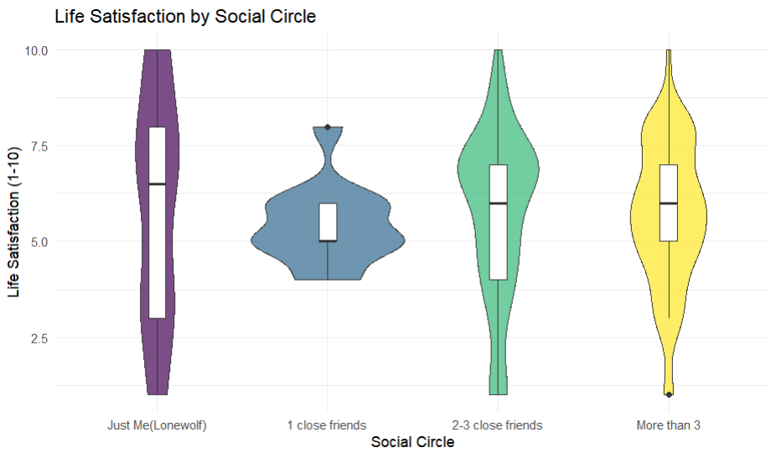
Results and Analysis
Profile of the Student Cohort:
Graph 7: Life Satisfaction by Social Circle
“Lonewolf” students show lowest median satisfaction and high variance.
Life satisfaction rises with larger social circles.
Students with 2–3 or more close friends report higher wellbeing.
Highlights social connection as a key wellbeing factor.

Slide 11
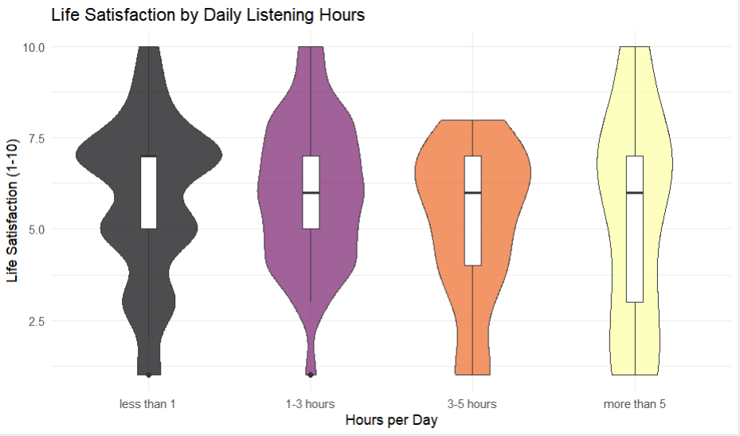
Results and Analysis
Profile of the Student Cohort:
Graph 8: Life Satisfaction by Daily Listening Hours
Peak satisfaction: 1–3 hrs and 3–5 hrs/day listeners.
Lowest satisfaction: <1 hr and >5 hrs/day groups.
Suggests excessive listening may reflect escapism or coping with low wellbeing.
Relationship is non-linear — more music ≠ more happiness.

Slide 12
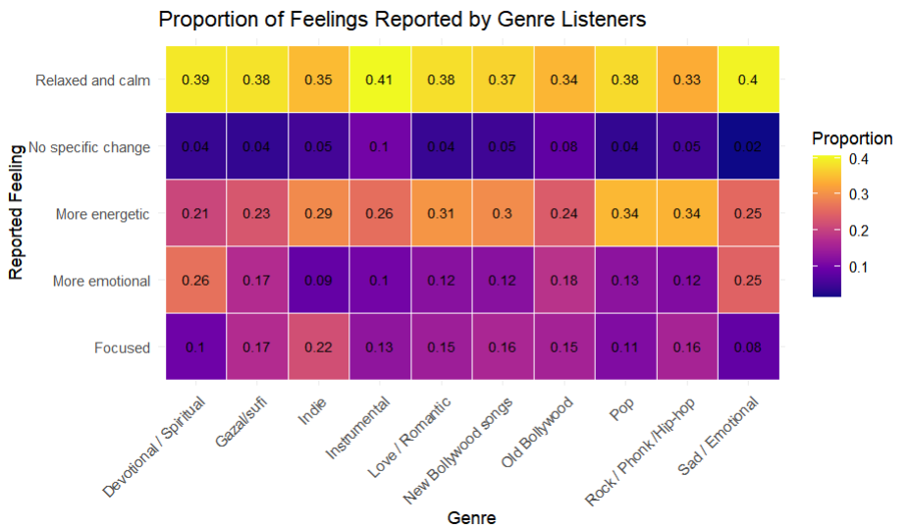
Results and Analysis
Profile of the Student Cohort:
Graph 9: Proportion of Feelings Reported by Genre Listeners
Each genre shows a unique emotional correlation pattern.
Instrumental → Relaxed & Calm (0.41)
Rock/Phonk/Hip-hop → Energetic (0.34)
Sad/Emotional → Relaxed & Calm (0.40) → “Sad music paradox”

Slide 13
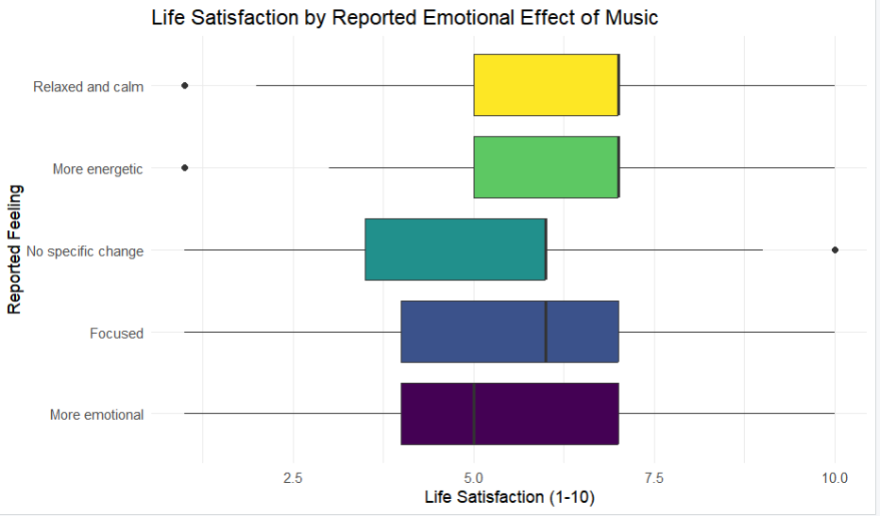
Results and Analysis
Profile of the Student Cohort:
Graph 10: Life Satisfaction by Reported Emotional Effect of Music
Core finding: How students use music matters more than what they listen to.
Highest satisfaction: Students using music to feel Relaxed or Energetic.
Lowest satisfaction: Those feeling More Emotional while listening.
Confirms the “Function > Content” hypothesis — music’s purpose drives wellbeing impact.

Slide 14
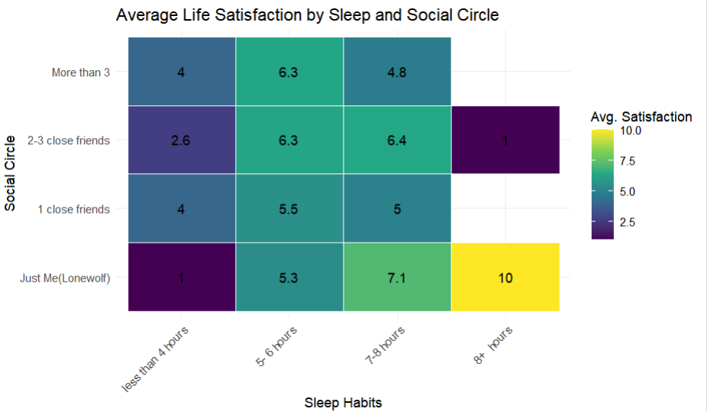
Results and Analysis
Profile of the Student Cohort:
Graph 11: Average Life Satisfaction by Sleep and Social Circle
Sleep and social connection act additively to influence wellbeing.
Lowest scores (1.0–2.6): Students sleeping <4 hours.
Highest scores (8.6–10): Students sleeping 8+ hours.
High variance in well-rested groups shows other factors (like social life) also play a major role.

Slide 15
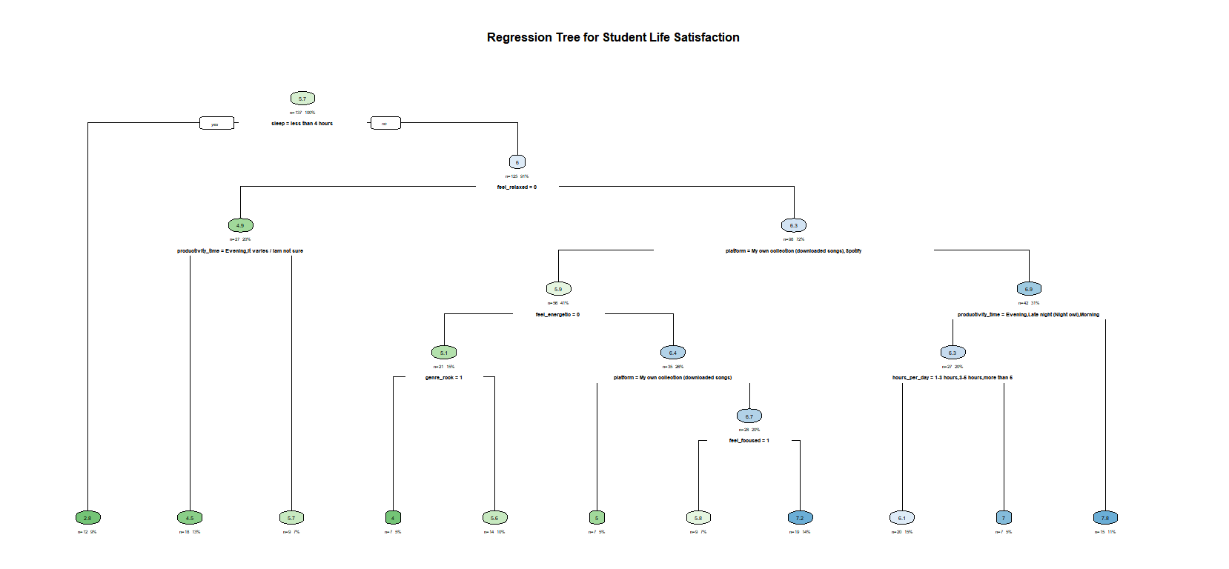
Results and Analysis
Profile of the Student Cohort:
Graph 12: Regression Tree for Student Life Satisfaction
Primary Split:
Sleep < 4 hours → lowest satisfaction → confirms sleep as top predictor.
Secondary Split:
Among well-rested students, key factor is “Does music make you feel relaxed?”
Emotional function of music outweighs social or time factors.
Leaf Profiles:
Low group: <4 hrs sleep + irregular routine → avg. score 2.9
High group: Adequate sleep + relaxed-by-music + Spotify → scores 6.1–7.1
Reveals a hierarchy of wellbeing needs — sleep first, emotional music function next.

Slide 16
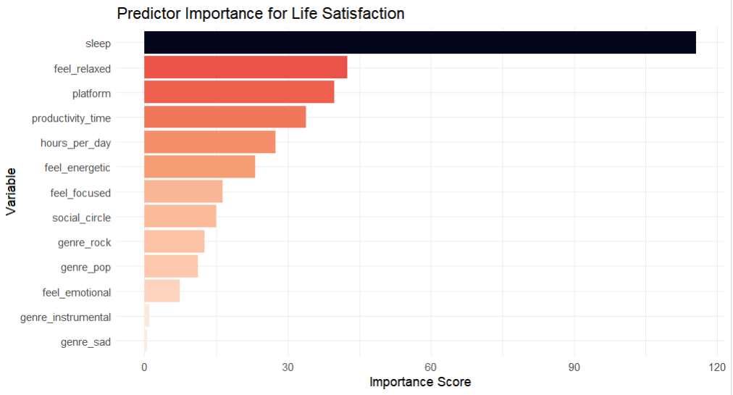
Results and Analysis
Profile of the Student Cohort:
Graph 13: Predictor Importance for Life Satisfaction
Sleep is the strongest predictor of student wellbeing.
Second most important: Music’s emotional function — feeling relaxed while listening.
Confirms: Foundational health (sleep) > Music function (relaxation) > Music content (genre).
Quantitatively supports the core thesis — wellbeing depends on how music is used, not what is heard.

Slide 17
Conclusion
Clear hierarchy of wellbeing factors identified from student data.
Sleep is the strongest predictor of life satisfaction; social connection also key.
Music’s emotional function > genre type — “Function over Content” confirmed.
Thriving students: well-rested, socially connected, use music for calm & focus.
Struggling students: sleep-deprived, use music to amplify negative emotions.
Core insight: Wellbeing = Strong health foundation + mindful music use.

Slide 18
THANK YOU

